Slide 1
Advance Java
Java Logging
LEVEL – PRACTITIONER

Slide 2
About the Author
Created By: | Renjith(t-renjith)/Shanmu (105110)
Credential Information: | Trainer/Sr Architect
Version and Date: | 1.0, February 1’st 2012
Cognizant Certified Official Curriculum
Notes:
For tde animators:
tdis screen content needs to be rendered in tde flash, no animations needed.

Slide 3









Icons Used
Hands on Exercise
Questions
Tools
Coding Standards
Test Your Understanding
Case Study
Best Practices & Industry Standards
Demonstration
Workshop

Slide 4
Objectives
After completing this chapter you will be able to understand:
What is logging?
Different logging level
What is log4j logger
How to configure log4j.
How to add log information to a file

Slide 5
A Problem Developer Faces
Scenario: Assume you are developer of a web application, the web application is
hosted to customers in US. Assume that you are staying in India and maintaining
the application. When you go to office at 10:00 AM you find out that customers have
faced some serious problems accessing the application at around 1:00 AM IST.
The customers are asking you to find the root cause of the problem and provide a report
to them?
Question: How will you analyze the problem which has happened 9 hours back?
Logging is the solution.

Slide 6
What is Logging?
Logging means recording the activities of a program/application in a log file.
The log files can be analyzed to trouble shoot problems.
Logged information helps to analyze the execution flow of the application.
What can be logged?
Input parameters of a method.
Some debug information to trouble shoot the execution flow.
Return values of a method.
Exception stack trace.

Slide 7
Logging frameworks
Logging
java.util.logging
log4j
“Whatever JUL can do, Log4j can also do - and more.”
We will discuss about the commonly used log4j in the coming slides
Notes:
To the Trainer
java.util.logging(JUL) is a part of the logging specification introduced by sun. It is almost identical to log4j in terms of functionality. Eventhough JUL came after log4j,still it lacks in some features specially in supporting features for web applications. Log4j is also used by open source projects such as hibernate, spring etc

Slide 8
Main components of log4j
Logger – The objects the application uses to log the message.
Appender – Used to send the information given by the loggers to different destination like console ,file , message queues.
Layouts – Use to make your own layout of the logged message.

Slide 9
Logging Levels in log4j
The various logging levels,
Debug
Info
Warn
Error
Fatal
Notes:
To the Trainer

Slide 10

Debug Level
Definition: Used for debugging the application.
When used: This is typically used to,
Find whether a statements are executed and the intermediate values of the execution.
Used in IF-ELSE blocks to find out the flow of execution.
What is production environment?
Assume we develop application for a retail customer. For the retail customers to access we need to deploy the application in a dedicated server. The server and other supporting software's are referred to as production environment.
NOTE:
The debug mode will be normally turned “OFF” in production environment.
Notes:
To The Trainer
In the case of multi threaded applications, it will be difficult to debug
the application using the normal debug mode execution so we log the
values into the log using the debug level.

Slide 11
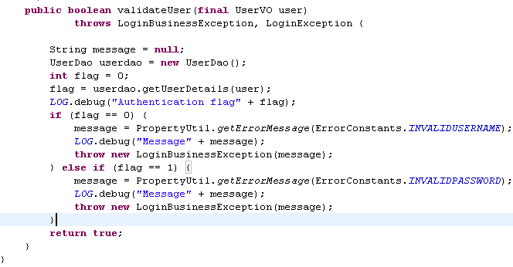
How to debug?
Syntax:
public static final Logger LOG = Logger.getLogger("LoginBO");
LOG.debug("Message" + <Variables>);
Debug statement printing the values in a method.

Slide 12
Info Level
Definition: Used to log values for information purpose only.
When used: This is usually used to,
Print the methods entry and exit.
Used for printing the input parameters and return values.
Any other relevant information which the developer thinks that it is needed to analyze the application in production.
NOTE:
The Info mode will be normally turned ‘ON’ in production environment.

Slide 13
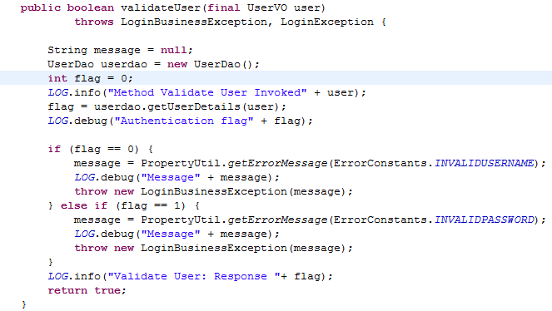
How to log information?
Syntax:
public static final Logger LOG = Logger.getLogger("LoginBO");
LOG.Info("Message" + <Variables>);
Info statement printing the method input.
Info statement printing the method output.

Slide 14
Error Level
Definition: Used to log all the exception occurring in the application .
When used: This is always used inside catch blocks to print the stack trace.
This is used for trouble shooting the exceptions thrown by application.
NOTE:
The error mode will be always be turned ‘ON’ in production environment.

Slide 15
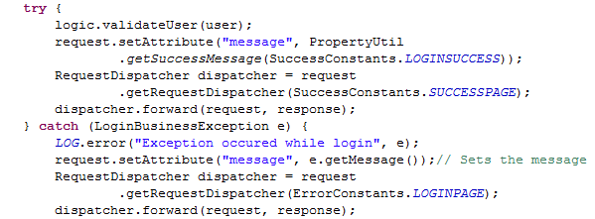
How to log error?
Syntax:
public static final Logger LOG = Logger.getLogger("LoginBO");
LOG.Error(“Exception occurred" + <exception>);
Where, exception is the throwable error object.
Stack trace being logged using error level.

Slide 16
Fatal Level
Definition: Used to log serious errors which may lead to system crash.
When used: Used to log fatal errors which are unrecoverable, such as
database connection lost, Application property file used by resource bundle missing.
Used inside exception catch blocks which the developer feels that the
exception is fatal.
Syntax:
public static final Logger LOG = Logger.getLogger("LoginBO");
LOG.Fatal(“Exception occurred" + <exception>);

Slide 17
Steps For Using Log4j
Step 1 : Create log4j.properties file.
Step 2 : Add log4j jar file web-inf lib folder
Step 3 : Load the log4j properties file in a startup servlet. Which loads the property files during application startup.
Step 4 : Create the logger object in the class which needs to be logged.
Step 5 : Use the logger object to log the info/debug/error messages.

Slide 18
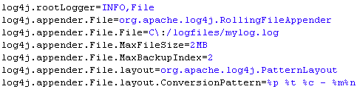
Step 1: Creating log4j.properties file
Create a file named log4j.properties inside the web-inf directory that contains the the configuration information for log4j.
Logging levels required.
Unique name set for the logger in the log file
Appender used
Log file name

Slide 19
Logging Levels Hierarchy
Fatal
Maximum level
When a particular level is set, all the levels above it will be automatically enabled.
Example : If the level is set as info all the levels above it namely warn,error,fatal will be enabled.
This means all the below statements will log the message in the log file
log.error(….) , log.fatal(…) , log.warn().
Log.debug() WILL NOT log any messages in the log file as it is below the info level.
Error
Warn
info
Debug
Minimum level

Slide 20
Step 2 : Copy log4j.jar to WEB-INF
Download log4j zip from the below location
http://logging.apache.org/log4j/1.2/download.html
Unzip the zip archive , copy the log4j jar file and place it inside the web-inf\lib folder.

Slide 21
Step 3: Loading log4j.properties
We need to load the log4j.properties file before using it.
Syntax:
PropertyConfigurator.configure(fileName);
Where fileName is the absolute path of the properties file.
NOTE: The loading will be done once for a web application a simple servlet will be developed with the init method invoking this statement.

Slide 22
Step 4: to Create a Logger Object ?
Syntax :
Logger LOG=Logger.getLogger(loggerName);
Where loggerName will be mostly the class name
Example :
Logger LOG=Logger.getLogger(TaxBo.class);

Slide 23
Do’s using loggers
Do’s:
All catch blocks should have log.error with the exception stack logged.
Use meaning full log messages which can be understood when analyzing the log files.
All method input parameter and return values needs to be logged using log.info
Wherever necessary add the log.debug statements which will help you to trouble shoot problems.

Slide 24
Do’s & Don’ts using loggers
Dont’s:
Avoid logging sensitive data like password.
Avoid logging unnecessary info statements, rather use log.debug.
Impact: The info level will be ‘ON’ during production, unnecessary
logging will make the log file bulkier and also degrades the application
performance.
Avoid logging information inside for loops.
Impact: Logging inside for loops will hinder the response time and clutters
the log file making it tough to analyze the log file.

Slide 25
Lend a Hand - Logging
We will reuse the MVC demo application to see how log4j can be configured to log the messages in a web application.
We will provide logging in the following components
RegistrationController servlet
RegistrationBO
LoggerInitializer servlet : A servlet used for initializing the logger in it’s init phase. The servlet can be made to start automatically on application start up by configuring in web.xml file

Slide 26
Step 1 : Create log4j.properties file in web-inf folder
Create a file named log4j.properties in the web-inf folder with following contents.

Slide 27
Step 2 : Place the log4j.jar in web-inf lib folder
Download log4j zip from the following location
http://logging.apache.org/log4j/1.2/download.html
Unzip the archive , copy log4j.jar and place it in
web-inf/ lib folder

Slide 28
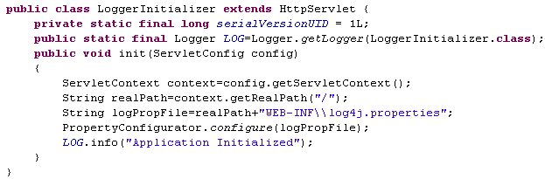
Step 3 : Create LoggerInitializer servlet and load log4j Properties file
The init method is overridden to read the real path using the servlet context object. The property file is then configured using the configure() method of the PropertyManager class .
IMPORTANT NOTE: The loading will be done only in one place in a web application. Typically it will be developed by one developer. And all other developers need to only use the logger initialize.

Slide 29
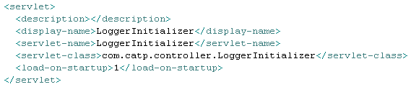
Step 3 (Cont) : Start up of LoggerInitializer Servlet
Add a load on start up option for the LoggerInitializer servlet in the web.xml file.
This is done to ensure that the Servlet Initializer is loaded before all the other servlets in the application.

Slide 30
Step 4 : Create a Logger Object
Create a logger object in registration controller as a instance variable and initialize it as below.
Pass the name of the class
Note :
A logger object should be always declared as private static final member
Since being a final member the identifier should be capitalized

Slide 31
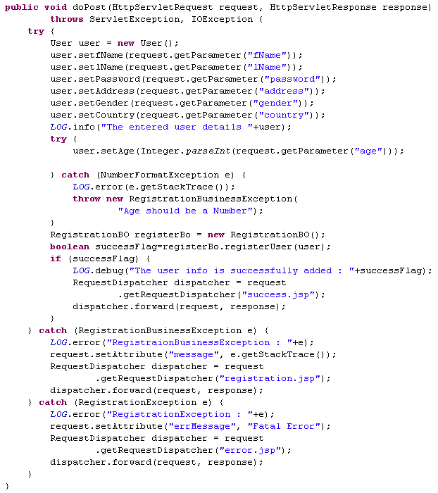
Step 5 : Add the necessary logging – Registration Controller
User object added as info to the logger.
Notice that the user object is directly printed to the logger.
Can we print a normal user object as it is ?
Refer next slide for details.
Log.error used to add exception details into the log file. This should be added in all the exception block.

Slide 32
Logging User defined Objects
Printing an object directly will not normally print the values of it’s members variables
How it is done?
To print the values of an object , override the toString() method as shown below.
How it works?
When a user tries to log or print the object using system.out.println, java automatically triggers the toString () method of the object and prints the string retuned.

Slide 33
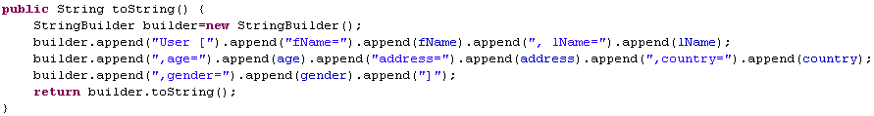
Lend A Hand: Override the toString in userBean
Now , override toString() method inside the User bean object so that when the bean object is printed it will print the values of it’s object.
Very Important NOTE: Never concatenate string using ‘+’ operator. Either use StringBuilder or StringBuffer

Slide 34
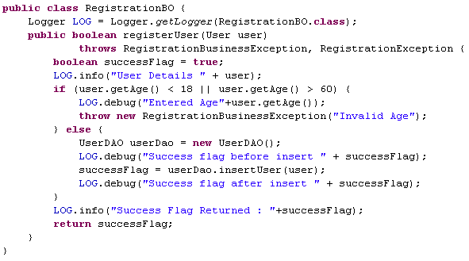
Step 5 : Adding Logging to RegistrationBO
Debug level logging added in the if and else block to debug the execution flow.
The input and method return value is displayed in Info level.

Slide 35
Lend a Hand -Deploy and Run
Step 1 : Deploy and run the application
Step 2 : Enter valid details into the registration form and submit
Step 3 : Enter invalid age into the registration form and submit.

Slide 36
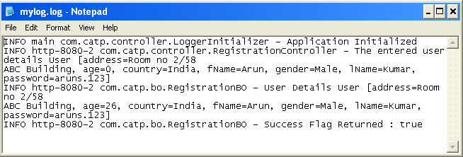
Lend a Hand -Log file output
The file can be found in the file specified in the log4j.properties file specified using the File attribute.
For Example log4j.appender.File.File=C\:/logfiles/mylog.log
We have added some debug level data in the RegistrationBO , but that data is missing in the log file .
What may be the reason ?
The reason is that the logging level set in log4j properties file is INFO which is greater than debug level hence debug information will not be displayed.
Change the value to debug level in log46.properties and run the application again and verify the output.

Slide 37

Time To Reflect
Associates to quickly summarize the following before ending the session
What is the logging level you will be using to log messages inside a catch block?
To change the log destination as console instead of file what attribute needs to be changed in the log4j.properties file?
Can we assure that setting the log level to fatal logs the error level information also?

Slide 38
Hands On Activity
Modify the CMS code with proper logging in the controllers and the Business object. Add a new servlet to initialize the log4j.properties file.
Ensure that all the methods in the controller and BO logs the following information,
log.info - For all the input and output of the methods.
log.debug – Print the debug messages in BO and Controller to trouble shoot the execution flow.
log.error - For logging all the exception in exception catch block.

Slide 39
Advance Java
You have successfully completed -
Logging

